Slide 1

Java course by Enered
Relaxed
Humorous

Slide 2
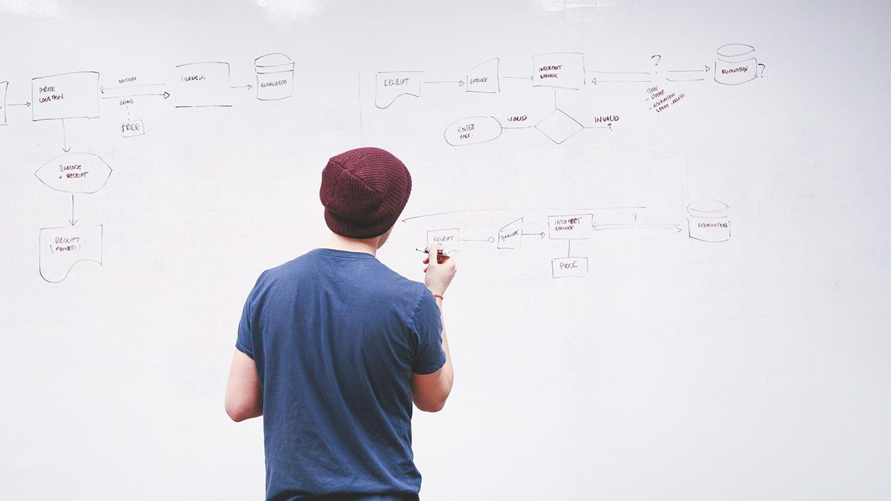
HELLO!
I am Vlad Butnaru
I will be your trainer for Java sessions!
PS: It’ll be awesome!

Slide 3
6+ years in IT
That’s a lot of cups of coffee
125 projects
And a lot nerves
15 projects
Were personal

Slide 4
16 years old
The age I started programming
17 years old
The age I had my first real job
18 years old
First job at a corporation (I hated every second of it)

Slide 5
1. Course organization
Let’s start with the real deal

Slide 6
Basic rules
We are equal, so no “Sir” or “Mister”, please! We are all passionate about what we do here.
You will become professionals, I will do everything I can do make that possible!
THE EMBLEM SYSTEM
You will be given emblems throughout the course.
Some emblems will expire in 7 days, other will last all course long. I encourage you to gather as many as possible since there is a high chance of getting a job ☺
THE TESTS
I will test your skills and knowledge every now an then.
Tests will be quick, to the point and will give me a general idea of what you actually understand.
THE FEEDBACK
It is essential for me to know where I have to improve, so be sincere and fair!
Consider it a gift for me, I love gifts!
THE COMMUNICATION
We have so many channles, please use them! We can talk by the phone, on facebook, on moodle, on skype or anywhere you want!

Slide 7
Useful links
https://github.com/vladutbutnaru/enered-java
http://online.enered.org
https://www.eclipse.org/downloads/
http://www.oracle.com/technetwork/java/javase/downloads/index.html
http://goo.gl/forms/ARBqgoCk5C
.

Slide 8
THE PROJECT
You will team up and create an amazing project using your skills and collaboration

Slide 9
Do’s and don’ts
DO
Help others if in need
Ask questions
Come up with brilliant solutions
Correct mistakes
Be proactive
Be a good teammate
DON’T
Be arrogant
Disrespect others
Make stupid jokes
Interrupt others
SKIP CLASSES
Damage any goods
Be afraid to ask questions

Slide 10
2. Let’s get to know each other
Who are you? What do you want to achieve?

Slide 11
Java developer
Java automated tester
Java System Architect
“One of the most beautiful qualities of true friendship is to understand and to be understood”
Java Guru
Java Freelancer
Java Consultant

Slide 12
Break ☺

Slide 13
Session Climates
Relaxed
Intense
Serious
Humorous

Slide 14
3. What is this Java thing?
No, really, what is it?

Slide 15
Well…
Java was originally designed for interactive TV
2nd most popular programming language (after the hidious C)
It runs on almost all devices
It is powering 95% of all Enterprise apps
Pretty interesting, huh?

Slide 16
There are 2 major directions
Java SE (Standard Edition)
This version is used mainly for desktop applications, that run for a small number of clients. It’s features allow you to create a modern application that runs on any operating system.
Java EE (Enterprise edition)
This version is used mainly for web applications. There is a server that serves the Java app to a big number of clients simultainiously. To date, it is the most used programming language for enterprise solutions.

Slide 17
80,000,000+
Applications & libraries built using Java technologies

Slide 18
400 euro
The minimum salary of a Junior Java Developer
30+
Companies in Iasi that have Java departments
50+
Java-related jobs monthly

Slide 19
~6 months
The time it takes to pass a Junior interview
1.5+ years
The time until you can reach Medior level
3+ years
The time until you can reach Senior level

Slide 20

Does that motivate you? I REALLY HOPE SO

Slide 21
I receive ~3 job requests weekly
…and I am not the only one complaining

Slide 22
International standard
You

Slide 23
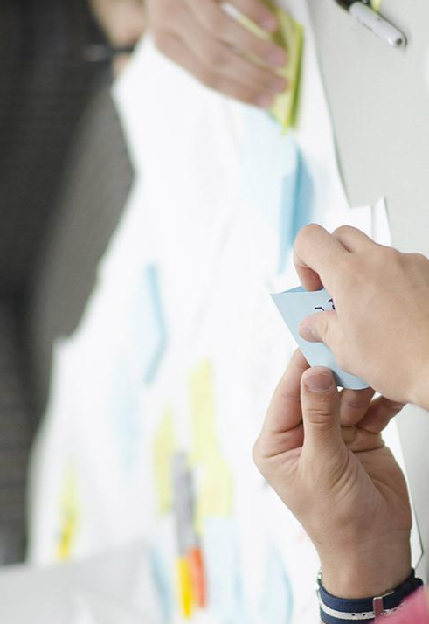
One language for all businesses
Java technologies are so complex, that is the perfect solution for building small to huge applications for any purprose.

Slide 24
Main JAVA Advantages
Object Oriented
Everything is an Object
Platform independent
Java <3 JVM
Secure
End-to-end encryption
Architectural-neutral
Unlimited power
Portable
Embedded/Mobile
Robust
More runtime, less exceptions
Multithreaded
Even more power
Distributed
Parallel execution
Fun
Fun to learn, fun to develop

Slide 25
Home setup
JDK http://www.oracle.com/technetwork/java/javase/downloads/jdk8-downloads-2133151.html
Eclipse http://www.eclipse.org/downloads/packages/eclipse-ide-java-developers/mars2
Works on Windows/Mac OSX/Linux
Respect the order, please!

Slide 26
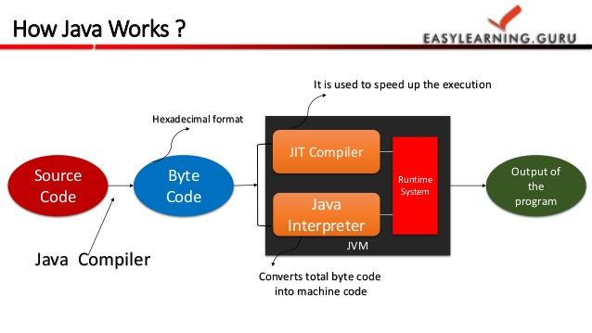
Java Execution Scheme

Slide 27
Break ☺

Slide 28
4. Introduction to programming (I)
Flow controls are all over the place!

Slide 29
Programming essentials
The computer knows nothing!
Everything our app does is data processing
Programs solve problems through a process
We are memory and processing power dependent
We are also dependent on syntax and vocabulary
You should NEVER reinvent the wheel

Slide 30
Data
Variables
Algorithms
Processes
Flow controls…
Input
Processed data
Processing
Output

Slide 31
We have THIS, we want THAT by doing THIS.

Slide 32
The Java Syntax
Primitive types (int, double, char, String, etc.)
Objects (User, Product, Transaction, etc.)
Methods (add(),multiply(),login(), etc.)
Classes (blueprint of objects)

Slide 33
Primitive types

Slide 34
Methods

Slide 35
Classes

Slide 36
Objects

Slide 37
Example
I have 2 numbers, I want 1 number by adding them together.

Slide 38
Example
I have 2 bank account balances, I want 1 number by substraction.

Slide 39
Example
I have the length of a triangle base and height, I want 1 number by calculating the area.

Slide 40
ECLIPSE HANDS ON
Please implement these examples in Java, using Eclipse IDE

Slide 41
Break ☺

Slide 42
5. Github DEMO
You will find the presentations, assignments and resources there

Slide 43
6. Ending notes
What have you done today?

Slide 44
Session review
You met me ☺
I met you ☺
You know what Java is and how many opportunities it comes with
You understand flow controls
You know the Java basic syntax
You’ve built your first Java app! Good job!

Slide 45
THANKS!
Any questions?
You can find me at:
@web: http://vladbutnaru.com/
@facebook· Vladut Butnaru
@linkedin· Vlad Butnaru
@email : vlad2me@gmail.com
@phone : +40 0754 827 620

Slide 46
Feedback please!
http://bit.do/feedbackvlad

